Slide 1

Securing Information Systems
Chapter 8
Ali Bazarah
MIS 300

Slide 2
Learning Objectives
8.1 Why are information systems vulnerable to destruction, error, and abuse?
8.2 What is the business value of security and control?
8.3 What are the components of an organizational framework for security and control?
8.4 What are the most important tools and technologies for safeguarding information resources?
Notes:
This chapter discusses the need for security to guard information systems and data, as well as technologies used to secure information systems.

Slide 3
Why Systems are Vulnerable
Security
Policies, procedures, and technical measures used to prevent unauthorized access, alteration, theft, or physical damage to information systems
Controls
Methods, policies, and organizational procedures that ensure safety of organization’s assets; accuracy and reliability of its accounting records; and operational adherence to management standards

Slide 4
Why Systems are Vulnerable
Computerized information systems are vulnerable to destruction, misuse, error, fraud, and hardware or software failures.
Hackers, Internal Threats (Employees), and Software Vulnerability
Accessibility of networks
Hardware problems (breakdowns, configuration errors, damage from improper use or crime)
Software problems (programming errors, installation errors, unauthorized changes)
Disasters
Use of networks/computers outside of firm’s control
Loss and theft of portable devices
Notes:
This slide discusses the main categories of threats to information systems. Note that when large amounts of data are stored digitally, on computers and servers and in databases, they are vulnerable to many more kinds of threats than when they were stored in manual form, on paper in folders and file cabinets. When data are available over a network, there are even more vulnerabilities.

Slide 5
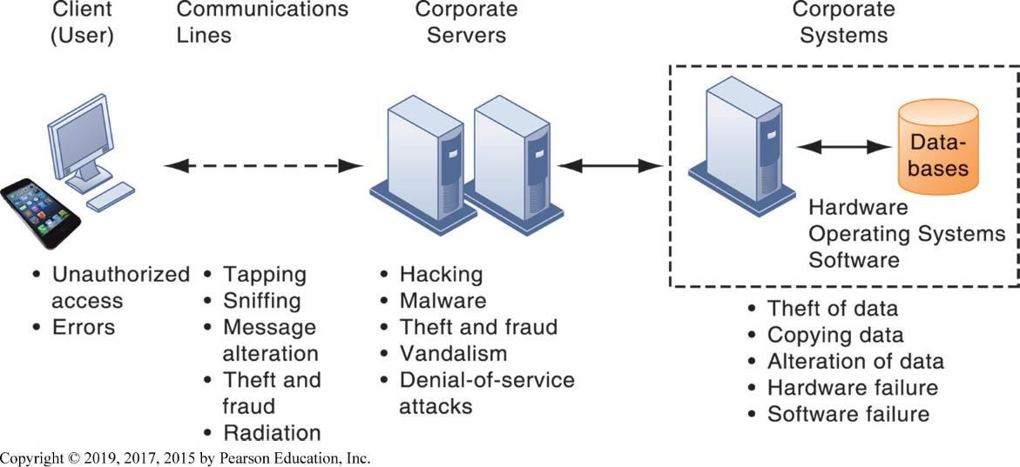
Figure 8.1 Contemporary Security Challenges and Vulnerabilities
Notes:
Figure 8.1, Page 276.
The architecture of a web-based application typically includes a web client, a server, and corporate information systems linked to databases. Each of these components presents security challenges and vulnerabilities. Floods, fires, power failures, and other electrical problems can cause disruptions at any point in the network.
This graphic illustrates the types of threats to system security and the points over the network at which these threats are prevalent. Some problems occur at the client computer, others through the network lines, corporate servers, or in corporate hardware and software.

Slide 6
Internet Vulnerabilities
Network open to anyone
Size of Internet means abuses can have wide impact
Use of fixed Internet addresses with cable / D S L modems creates fixed targets for hackers
Email, P2P file-sharing programs, I M
Attachments with malicious software
Notes:
This slide discusses the types of threats that large public networks, such as the Internet, face because they are open to virtually anyone. Note that the Internet is so huge that when abuses do occur, they can have an enormously widespread impact. And when the Internet becomes part of the corporate network, the organization’s information systems are even more vulnerable to actions from outsiders.

Slide 7
Wireless Security Challenges
WIFI frequency bands easy to scan
S S I Ds (service set identifiers)
Identify access points, broadcast multiple times, can be identified by sniffer programs
War driving
Eavesdroppers drive by buildings and try to detect S S I D and gain access to network and resources
Once access point is breached, intruder can gain access to networked drives and files
Notes:
This slide discusses security threats related to wireless networks. Local area networks (LANs) using the 802.11 standard can be easily penetrated by outsiders armed with laptops, wireless cards, external antennae, and hacking software. Hackers use these tools to detect unprotected networks, monitor network traffic, and, in some cases, gain access to the Internet or to corporate networks

Slide 8
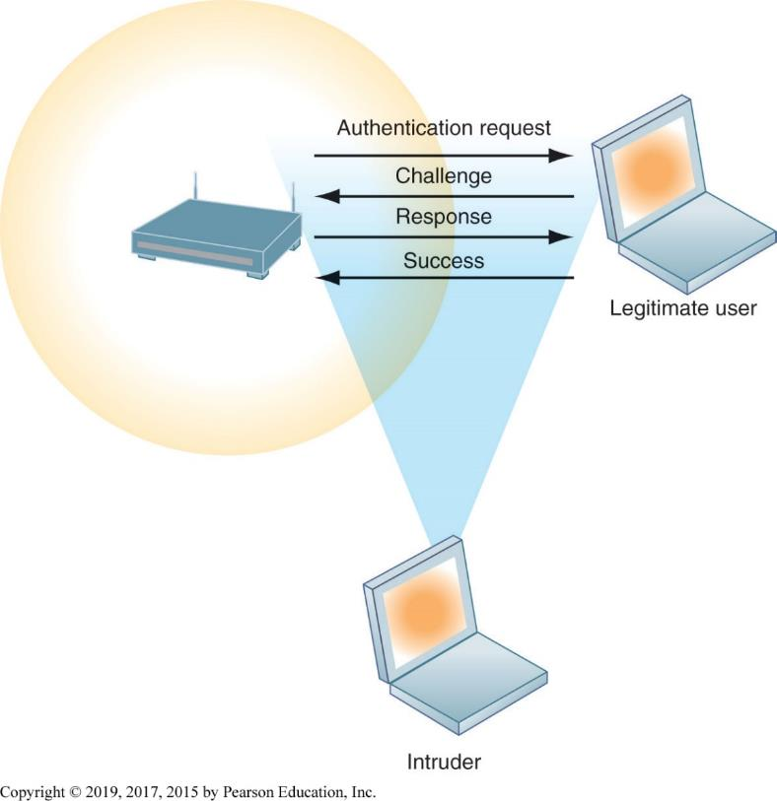
Figure 8.2 Wi-Fi Security Challenges
Notes:
Figure 8.2, Page 277.
Many Wi-Fi networks can be penetrated easily by intruders using sniffer programs to obtain an address to access the resources of a network without authorization.
This graphic illustrates why wireless networks are vulnerable—the service set identifiers (SSIDs) identifying the access points in a Wi-Fi network are broadcast multiple times (as illustrated by the orange sphere) and can be picked up fairly easily by intruders’ sniffer programs.

Slide 9
Sony PlayStation hacked
https://www.youtube.com/watch?v=GgQlTNIl0-E

Slide 10
Malicious Software:
Malicious Software: is any program or file that is harmful to a computer user
Viruses: A program that replicates itself by being copied or initiating its copying to another program
Worms: A self-replicating virus that does not alter files but resides in active memory and duplicates itself without human intervention
Trojan Horses: program that appears legitimate but contains a second hidden function that may cause damage.
Notes:
This slide introduces the need for both security and controls in today’s businesses in order to safeguard information systems

Slide 11
Malicious Software: Viruses, Worms, Trojan Horses, and Spyware
Malware (malicious software)
Viruses
Worms
Worms and viruses spread by
Downloads and drive-by downloads
Email, I M attachments
Mobile device malware
Social network malware
Notes:
This slide identifies the various types of malware that threaten information systems and computers. Note that there are now thousands of viruses and worms targeting mobile phones, and Web 2.0 applications such as Facebook, Pinterest, and blogs are new conduits for malware and spyware. Malware is a serious problem—over the past decade, worms and viruses have caused billions of dollars of damage to corporate networks, email systems, and data.

Slide 12
Malicious Software:
Spyware: programs that gather information about a computer user without permission
S Q L injection attacks: take advantage of vulnerabilities in poorly coded web application software to introduce malicious program
Ransomware:tries to extort money from users by taking control of their computers, blocking access to files, or displaying annoying pop-up messages.
Notes:
This slide continues the discussion of types of malware on the previous slide. Note that SQL injection attacks are the largest malware threat. (These attacks enable hackers access to underlying databases that support web applications, such as sales of products and services, e-commerce financial data, and other classified information. In other words, the database is where the information is located. SQL databases have little or no built in security once a hacker gets beyond the entrance point to a corporate network).

Slide 13
Interactive Session Technology – WannaCry and the SWIFT System Hacking Attacks: Theft on a Worldwide Scale
Class discussion
Compare the WannaCry and SWIFT system hacking attacks. What security vulnerabilities were exploited in each of these attacks?
What people, organization, and technology factors contributed to these security weaknesses?
How could these attacks have been prevented?
What was the business and social impact of these attacks?

Slide 14
Hackers and Computer Crime (1 of 3)
Hackers: an individual who intends to gain unauthorized access to a computer system.
Activities include:
System intrusion
System damage
Cybervandalism
Intentional disruption, destruction of website or corporate information system
Notes:
This slide looks at the people who commit computer crime, and at the various types of computer crime.

Slide 15
Hackers and Computer Crime (2 of 3)
Denial-of-service attacks (D o S ): flood a network server or web server with many thousands of false communications or requests for services to crash the network.
Computer crime
Computer may be target of crime
Computer may be instrument of crime

Slide 16
Hackers and Computer Crime (3 of 3)
Identity theft: obtains key pieces of personal information, such as social security
Phishing: Involves setting up fake websites or sending email messages that look like those of legitimate businesses to ask users for confidential personal data.
Evil twins: wireless networks that pretend to offer trustworthy Wi-Fi connections to the Internet, such as those in airport lounges, hotels, or coffee shops.
Pharming: redirects users to a bogus web page, even when the individual types the correct web page address into his or her browser.
Notes:
This slide continues the discussion of types of computer crime. Congress addressed the threat of computer crime in 1986 with the Computer Fraud and Abuse Act. This act makes it illegal to access a computer system without authorization.
This slide continues the discussion of types of computer crime.

Slide 17
Internal Threats: Employees
Security threats often originate inside an organization
Inside knowledge
Sloppy security procedures
User lack of knowledge (stealing passwords)
Social engineering: Tricking people into revealing their passwords by pretending to be legitimate users
Both end users and information systems specialists are sources of risk
Notes:
This slide looks at another source of security problems—people inside the company with access to the system

Slide 18
Software Vulnerability
Commercial software contains flaws that create security vulnerabilities
Bugs (program code defects)
Zero defects cannot be achieved
Flaws can open networks to intruders
Patches
Small pieces of software to repair flaws
Patch management(apply to all flaws)

Slide 19
What is the Business Value of Security and Control?
Security and control are important but often neglected areas for information systems investments.
Failed computer systems can lead to significant or total loss of business function
Firms now are more vulnerable than ever
Confidential personal and financial data
Trade secrets, new products, strategies
Inadequate security and controls also bring forth issues of liability

Slide 20
1- Legal and Regulatory Requirements for Electronic Records Management
H I P A A (Health Insurance Portability and Accountability Act)
Medical security and privacy rules and procedures
Gramm-Leach-Bliley Act
Requires financial institutions to ensure the security and confidentiality of customer data
Sarbanes-Oxley Act (publicly trade company)
Imposes responsibility on companies and their management to safeguard the accuracy and integrity of financial information that is used internally and released externally

Slide 21
2- Electronic Evidence and Computer Forensics
Electronic evidence
Evidence of crimes often in digital form
Proper control of data can save time and money when responding to legal discovery request
Computer forensics
Scientific collection, examination, authentication, preservation, and analysis of data from computer storage media for use as evidence in court of law
Notes:
This slide continues the discussion of the business value of security and control. Security, control, and electronic records management are essential today for responding to legal actions.
Note that in a legal action, a firm is obligated to respond to a discovery request for access to information that may be used as evidence, and the company is required by law to produce those data. The cost of responding to a discovery request can be enormous if the company has trouble assembling the required data or the data have been corrupted or destroyed. Courts impose severe financial and even criminal penalties for improper destruction of electronic documents.

Slide 22
Components Information Systems Controls
Even with the best security tools, your information systems won’t be reliable and secure unless you know
how and where to deploy them.
Controls may be automated or manual
General controls
Govern design, security, and use of computer programs and security of data files in general throughout organization
Includes software controls, hardware controls, computer operations controls, data security controls, system development controls, administrative controls,
Application controls
Specific controls unique to each computerized application (payroll)
Input controls, processing controls, output controls

Slide 23
Risk Assessment
Determines level of risk to firm if specific activity or process is not properly controlled
Types of threat
Probability of occurrence during year
Potential losses, value of threat
Expected annual loss
what you need to protect
what you need to protect it from
how to protect it

Slide 24
Table 8.5 Online Order Processing Risk Assessment
Exposure | Probability of Occurrence | Loss Range (Average) ($) | Expected Annual Loss ($)
Power failure | 30% | $5,000 − $200,000 ($102,500) | $30,750
Embezzlement | 5% | $1,000 − $50,000 ($25,500) | $1275
User error | 98% | $200 − $40,000 ($20,100) | $19,698
Notes:
The table illustrates sample results of a risk assessment for an online order processing system that processes 30,000 orders per day. The likelihood of each exposure occurring over a one-year period is expressed as a percentage. The expected annual loss is the result of multiplying the probability by the average loss.

Slide 25
Security Policy
Statement ranks information risks, identifies security goals and mechanisms for achieving these goals
Drives other policies
Acceptable use policy (A U P )
Defines acceptable/unacceptable uses of firm’s information resources and computing equipment
desktop and laptop computers, wireless devices
Identity management: Manages access to each part of the information system
Identifying valid users
Controlling access
Notes:
This slide looks at the need for a firm to establish a security policy for protecting a company’s assets, as well as other company policies the security policy drives, and how information systems support this. The text provides the example of the security policy at Unilever, a multinational consumer goods company, which requires every employee with a laptop or mobile handheld to use an approved device and employ a password or other method of identification when logging onto the corporate network
This slide looks at the area of security policy involved in managing identities of system users

Slide 26
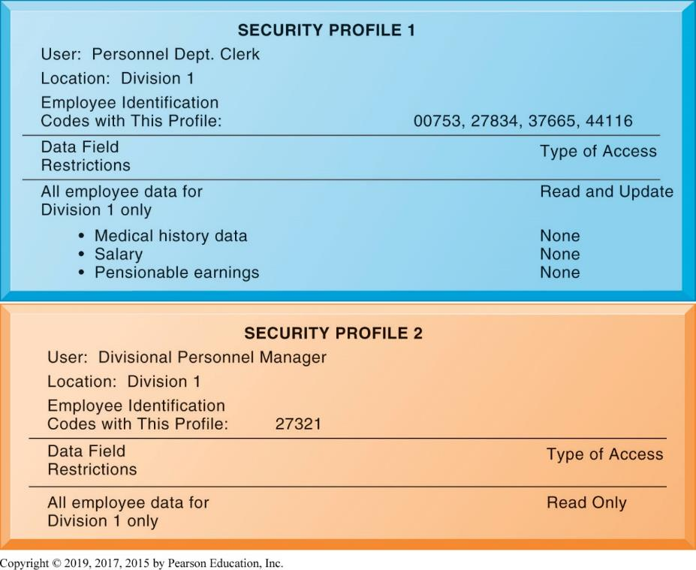
Figure 8.3 Access Rules for a Personnel System
Notes:
Figure 8.3, Page 291.
These two examples represent two security profiles or data security patterns that might be found in a personnel system. Depending on the security profile, a user would have certain restrictions on access to various systems, locations, or data in an organization.
This graphic illustrates the security allowed for two sets of users of a personnel database that contains sensitive information such as employees’ salaries and medical histories. One set of users consists of all employees who perform clerical functions, such as inputting employee data into the system. All individuals with this type of profile can update the system but can neither read nor update sensitive fields, such as salary, medical history, or earnings data. Another profile applies to a divisional manager, who cannot update the system but who can read all employee data fields for his or her division, including medical history and salary. These security profiles are based on access rules supplied by business groups in the firm.

Slide 27
Disaster Recovery Planning and Business Continuity Planning
Disaster recovery planning
Plans for restoration of disrupted services
Business continuity planning
Focuses on restoring business operations after disaster
Both types of plans needed to identify firm’s most critical systems
Management must determine which systems restored first
Notes:
This slide continues the discussion of essential activities a firm performs to maximize security and control, here looking at planning for activities should a disaster occur, such as a flood, earthquake, or power outage. Note that disaster recovery plans focus primarily on the technical issues involved in keeping systems up and running, such as which files to back up and the maintenance of backup computer systems or disaster recovery services. The text provides the example of MasterCard, which maintains a duplicate computer center in Kansas City, Missouri, to serve as an emergency backup to its primary computer center in St. Louis.

Slide 28
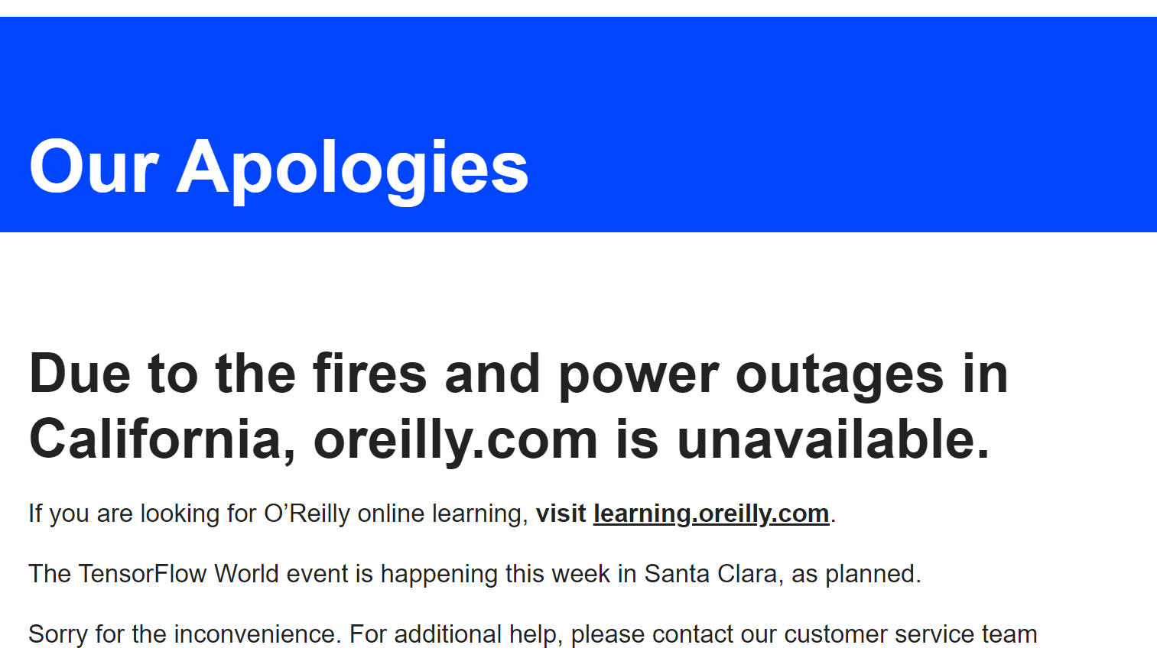

Slide 29
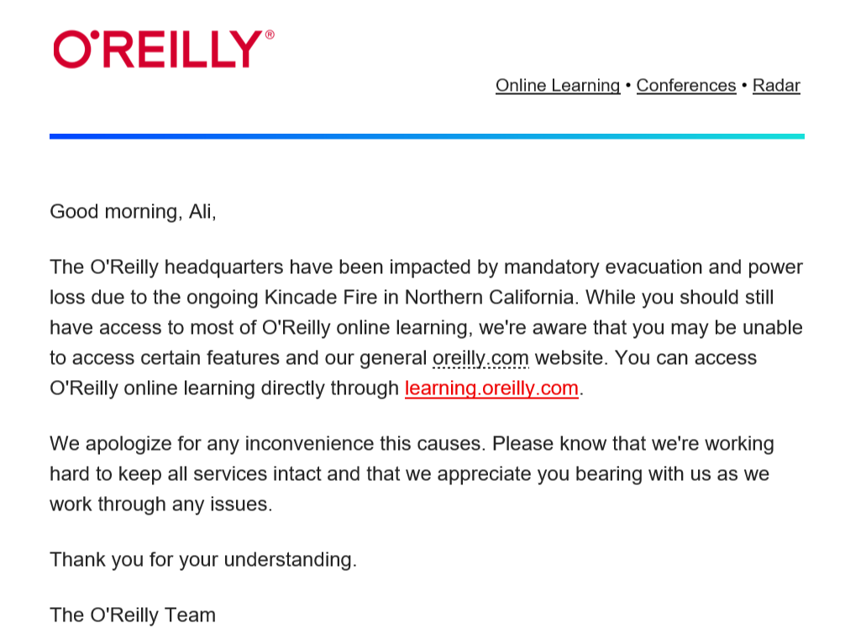

Slide 30
The Role of Auditing
Information systems audit
Examines firm’s overall security environment as well as controls governing individual information systems
Security audits
Review technologies, procedures, documentation, training, and personnel
May even simulate disaster to test responses
List and rank control weaknesses and the probability of occurrence
Assess financial and organizational impact of each threat
Notes:
This slide looks at the role of auditing. An MIS audit enables a firm to determine if existing security measures and controls are effective.

Slide 31
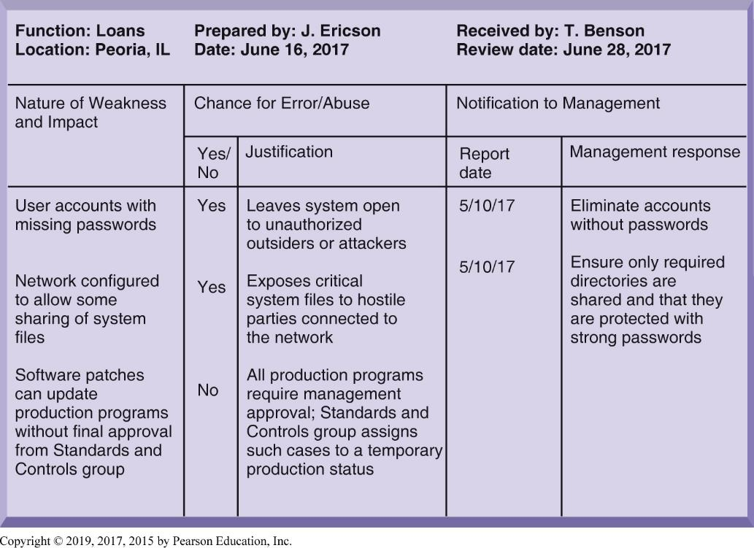
Figure 8.4 Sample Auditor’s List of Control Weaknesses
Notes:
Figure 8.4, Page 293.
This chart is a sample page from a list of control weaknesses that an auditor might find in a loan system in a local commercial bank. This form helps auditors record and evaluate control weaknesses and shows the results of discussing those weaknesses with management as well as any corrective actions management takes.
This graphic illustrates a sample page from an auditor’s listing of control weaknesses for a loan system. It includes a section for notifying management of such weaknesses and for management’s response. Management is expected to devise a plan for countering significant weaknesses in controls.

Slide 32
Tools and Technologies for Safeguarding Information Systems (1 of 3)
Identity management software
Automates keeping track of all users and privileges
Authenticates users, protecting identities, controlling access
Authentication
Password systems
Tokens
Smart cards
Biometric authentication
Two-factor authentication

Slide 33
Tools and Technologies for Safeguarding Information Systems (2 of 3)
Firewall
Combination of hardware and software that prevents unauthorized users from accessing private networks
Acts like a gatekeeper that examines each user’s credentials before it grants access to a network.
Notes:
This slide looks at an essential tool used to prevent intruders from accessing private networks—firewalls. To create a strong firewall, an administrator must maintain detailed internal rules identifying the people, applications, or addresses that are allowed or rejected. Firewalls can deter, but not completely prevent, network penetration by outsiders and should be viewed as one element in an overall security plan.

Slide 34
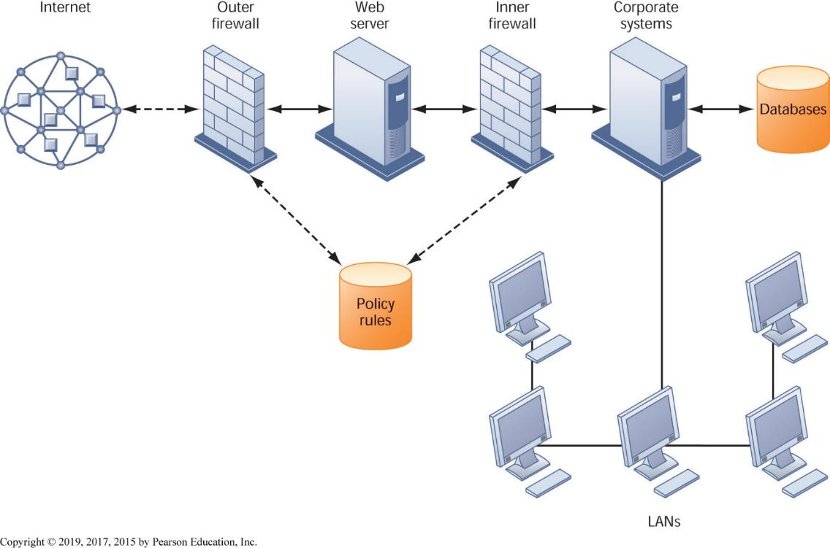
Figure 8.5 A Corporate Firewall
Notes:
Figure 8.5, Page 295.
The firewall is placed between the firm’s private network and the public Internet or another distrusted network to protect against unauthorized traffic.
This graphic illustrates the use of firewalls on a corporate network. Notice that here, a second, “inner” firewall protects the web server from access through the internal network.

Slide 35
Tools and Technologies for Safeguarding Information Systems (3 of 3)
Intrusion detection system
Monitors hot spots on corporate networks to detect and deter intruders
Antivirus and antispyware software
Checks computers for presence of malware and can often eliminate it as well
Requires continual updating
Unified threat management (U T M) systems
Notes:
This slide looks at additional tools to prevent unwanted intruders and software from accessing the network. Ask students what antivirus and antispyware tools they use. Ask why these tools require continual updating. Ask why UTM packages would include anti-spam software.

Slide 36
Encryption and Public Key Infrastructure
Encryption
Transforming text or data into cipher text that cannot be read by unintended recipients
Two methods of encryption of messages
Symmetric key encryption
Sender and receiver use single, shared key
Public key encryption
Uses two, mathematically related keys: public key and private key
Sender encrypts message with recipient’s public key
Recipient decrypts with private key
Notes:
This slide discusses the use of encryption to ensure that data traveling along networks cannot be read by unauthorized users. Ask students to explain the difference between symmetric key encryption and public key encryption. (In symmetric key encryption, the sender and receiver establish a secure Internet session by creating a single encryption key and sending it to the receiver so both the sender and receiver share the same key. Public key encryption uses two keys: one shared (or public) and one totally private. The keys are mathematically related so that data encrypted with one key can be decrypted using only the other key. To send and receive messages, communicators first create separate pairs of private and public keys. The public key is kept in a directory and the private key must be kept secret. The sender encrypts a message with the recipient’s public key. On receiving the message, the recipient uses his or her private key to decrypt it. Ask students why public key encryption is stronger than symmetric key encryption. Note that the strength of an encryption key is measured by its bit length. Today, a typical key will be 128 bits long (a string of 128 binary digits).

Slide 37
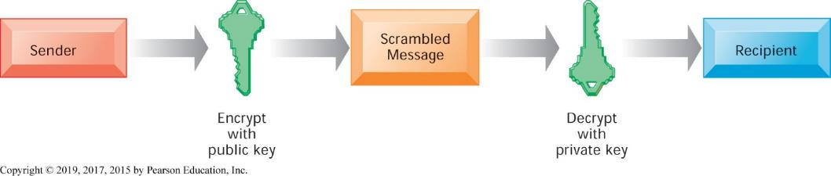
Figure 8.6 Public Key Encryption
Notes:
Figure 8.6, Page 297.
A public key encryption system can be viewed as a series of public and private keys that lock data when they are transmitted and unlock the data when they are received. The sender locates the recipient’s public key in a directory and uses it to encrypt a message. The message is sent in encrypted form over the Internet or a private network. When the encrypted message arrives, the recipient uses his or her private key to decrypt the data and read the message.
This graphic illustrates the steps in public key encryption. The sender encrypts data using the public key of the recipient; data encrypted with this public key can only be decrypted with the recipient’s private key.

Slide 38
Security Issues for Cloud Computing and the Mobile Digital Platform (1 of 2)
Security in the cloud
Responsibility for security resides with company owning the data
Firms must ensure providers provide adequate protection:
Where data are stored
Meeting corporate requirements, legal privacy laws
Segregation of data from other clients
Audits and security certifications
Notes:
This slide describes security concerns specific to cloud computing and mobile computing.

Slide 39
Security Issues for Cloud Computing and the Mobile Digital Platform (2 of 2)
Securing mobile platforms
Security policies should include and cover any special requirements for mobile devices
Guidelines for use of platforms and applications
Mobile device management tools
Authorization
Control updates
Lock down/erase lost devices
Encryption
Software for segregating corporate data on devices
Notes:
This slide looks at securing mobile systems. What specific concerns are there with mobile devices? (Encrypting communications, theft and loss, inventory records.) One very common security breach involves employees losing phones while traveling. In some cases, the rule is, “lose your phone, lose your job.” Mobile devices such as tablets will increasingly store a considerable amount of corporate information. Then again, if the data is largely stored in the cloud, and passwords are required for access, then the threat is reduced.

Slide 40
Ensuring Software Quality
Software metrics: Objective assessments of system in form of quantified measurements
Number of transactions
Online response time
Payroll checks printed per hour
Known bugs per hundred lines of code
Early and regular testing
Walkthrough: Review of specification or design document by small group of qualified people
Debugging: Process by which errors are eliminated
Notes:
This slide looks at ensuring software quality as a way to improve system quality and reliability by employing software metrics and rigorous software testing. Ongoing use of metrics allows the information systems department and end users to jointly measure the performance of the system and identify problems as they occur.

